Slide 1
Machine Learning
Machine Learning Introduction to Machine Learning by Kumar Anurupam is licensed under a Creative Commons Attribution-4.0 International License.
Artificial Neural Networks – CNN - II
CS 3104 Fall 2019
Lecture Slides by Kumar Anurupam

Slide 2
Learning Objectives
After completion of today’s session you will be able to:
Explain about the padding and strides in CNN.
Elaborate how to perform convolution on colored images.

Slide 3
Padding and Strides on Images
Padding is an approach by which we can get the output image of the same size as the original input image after applying the kernel on the input image.
In some problems using CNN we may require to significantly reduce the size of the image after the processing done by the kernel. In order to achieve this the concept of strides comes into play.

Slide 4
Padding
Padding can be done by these two following ways:
Zero Padding
Adjacent/Same value padding(Not preferred over zero padding)

Slide 5
Zero Padding
Output Image
0 | 0 | 0 | 0 | 0 | 0 | 0 | 0
0 | 0 | 0 | 0 | 0 | 0 | 0 | 0
0 | 0 | 0 | 0 | 0 | 0 | 0 | 0
0 | 0 | 0 | 0 | 0 | 0 | 0 | 0
0 | 255 | 255 | 255 | 255 | 255 | 255 | 0
0 | 255 | 255 | 255 | 255 | 255 | 255 | 0
0 | 255 | 255 | 255 | 255 | 255 | 255 | 0
0 | 0 | 0 | 0 | 0 | 0 | 0 | 0
+1 | +2 | +1
0 | 0 | 0
-1 | -2 | -1
*
3 X 3
(kernel/filter/mask/operator)
Padding, p = 1
One row/column on each side
6 X 6
Original: 6 X 6
Image Matrix
After padding: 8 X 8

Slide 6
Adjacent/same value Padding
Output Image
0 | 0 | 0 | 0 | 0 | 0 | 0 | 0
0 | 0 | 0 | 0 | 0 | 0 | 0 | 0
0 | 0 | 0 | 0 | 0 | 0 | 0 | 0
0 | 0 | 0 | 0 | 0 | 0 | 0 | 0
255 | 255 | 255 | 255 | 255 | 255 | 255 | 255
255 | 255 | 255 | 255 | 255 | 255 | 255 | 255
255 | 255 | 255 | 255 | 255 | 255 | 255 | 255
255 | 255 | 255 | 255 | 255 | 255 | 255 | 255
+1 | +2 | +1
0 | 0 | 0
-1 | -2 | -1
*
3 X 3
(kernel/filter/mask/operator)
Padding, p = 1
One row/column on each side
6 X 6
Original: 6 X 6
Image Matrix
After padding: 8 X 8

Slide 7
Convolution on Colored images
The grayscale images contains the values ranging from 0 – 255.
If we consider colored images then can be represented in one way as a combination of three colors i.e. RGB(Red, Green and Blue)
Each pixel can be understood as a combination of all three of the above mentioned colors.
In deep learning the RGB are called as channels.

Slide 8
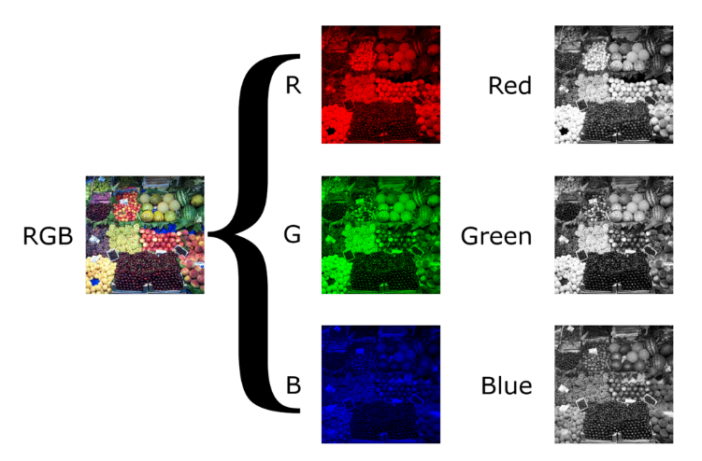
Colored image in RGB format

Slide 9
References
[1] https://en.wikipedia.org/wiki/Grayscale#/media/File:Beyoglu_4671_tricolor.png

Slide 10
Thanks

